Slide 1
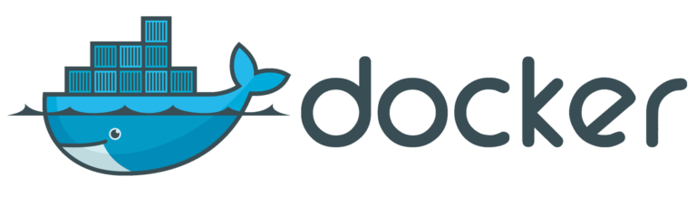
Containerizing Drupal in the Cloud with Docker and AWS
Chris Mitchell @motobreath
chris@chrismitchellonline.com

Slide 2
A little about ME
All things web developer 15+ years
Programmer Analyst for E&J Gallo Winery
Manage hosting and maintaining 100+ websites
Drupal / Docker / AWS / Javascript / PHP
First time meetup presenter, go easy!

Slide 3

Lets start with Drupal 7

Slide 4
What got us here
Monolithic Drupal and Server
100 + sites all on one server
All running different Drupal versions and configurations
Constant on call and monitoring
Updated AWS was our only chance

Slide 5


Slide 6
Enter Auto Scaling
AWS Load balancing
Auto scaling groups
Need for 3 tier architecture
S3
RDS
EC2

Slide 7
3 Tier Architecture
Application – PHP EC2
Database – MySQL / RDS
Storage – S3
https://www.drupal.org/project/s3fs
Solid application, increased complexity with deployments
Still all over the map with configuration!
Notes:
Add images about 3 tier architecture.

Slide 8
4th Tier – Amazon EFS Drive
Centralized storage
Great for configuration
Terrible for application reads but great for solving deployment

Slide 9
Walking on eggs…
Rolling out AMI’s to manage OS and PHP (Build server)
Still difficult to manage updates
Multiple (100+) sites are still on one server
Biggest problem, single apache

Slide 10


Slide 11
Dockerize Drupal
What is Docker
The key is 3 tier architecture
Still managing servers, but in smaller capacity and more automated
Drupal Core + individual site settings.local.php
Building Drupal core with composer

Slide 12
Balancing Dockerfile vs Docker commit
Dockerfile builds entire application
Docker commit creates a snapshot of a running Docker container
Never rely on Docker commit
Golden container syndrome
Some Docker commit is required (build container, modify, commit, deploy)
What can be done via Dockerfile and what must happen after
Notes:
Now we have a hosting environment, how to automate

Slide 13
Drupal Configuration
Drupal 8 configuration management
Export / Import configuration across multiple Drupal 8 sites
Drush cim – export configuration from DB to disk
Drush cex – import configuration from disk to DB
Maintain a uniform UX for content editors for multiple sites

Slide 14
Docker Compose
NOT Composer
Orchestrate container launching
Drupal + DB
.env

Slide 16
Amazon Elastic Container Service
Push containers to registry
Create launch tasks
Create services
Roll in new containers
Better error checking
Automated rollback

Slide 17
Application Load Balancer
Ability to route traffic from load balancer to container
SSL offloading on ALB
Free SSL!
Better firewalls / Web application firewall (WAF)

Slide 18
Automating a Drupal Build
Ubuntu
PHP / Apache
Composer / Application files
What is currently automated

Slide 19

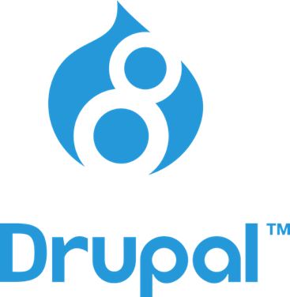
Headless Drupal
REST API endpoints
Drupal Views
No Drupal templates
Angular front end
Ability to offload front end development without special Drupal knowledge

Slide 20
Checklist Summary - Drupal
Docker
Drupal
Composer
S3FS

Slide 21
Checklist Summary - AWS
MySql – RDS
S3 Bucket
ECS
Repository
Task
Cluster
Service
EC2 / Load Balancer
Target Group
Domain name
Route 53 or custom
SSL cert (AWS)

Slide 22
What’s Next
Fargate ECS
Separate Drupal core into separate Docker container
Centralized Drupal core
Deploy one skeleton
Better use of env vars
DEV/STG/PROD
Use tasks in ECS to set

Slide 23
Thanks!
chris@chrismitchellonline.com
Twitter: @motobreath
Github: https://github.com/motobreath
Docker Hub motobreath

